Slide 1
Building Practical Desktop apps in Python Using the Core Tkinter Library
By Doug Purcell

Slide 2
Why Bother Learning How to Code GUI?
Makes your programs a lot more user friendly. Do you think Microsoft Windows would be as popular if users could only use the terminal?
Allows business folks or stakeholders to easily interface with the program
A solid way to get software engineers accustomed to quality UX principles

Slide 3
Why Tkinter?
It’s wired into python’s core.
It’s cross platform.
It’s a wrapper to the standard Tk GUI toolkit.
It’s easy to get started with.

Slide 4
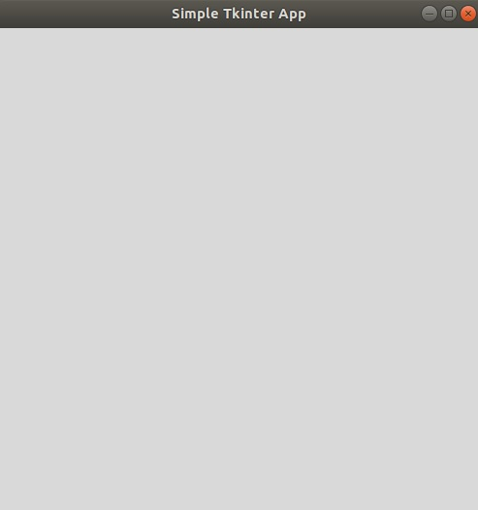
A Simple Tkinter GUI

Slide 5
The Code
import tkinter as tk
root = tk.Tk()
root.title('Simple Tkinter App')
root.geometry('500x500')
tk.mainloop()

Slide 6
If You Remember Anything, Remember That!

Slide 7
The First Line
import tkinter as tk

Slide 8
What It Does?
Imports the Tkinter module. You could also use the following to import ALL of the functionality from Tkinter:
from tkinter import *

Slide 9
The Second Line
root = tk.Tk()

Slide 10
What It Does?
This starts the tcl/tk interpreter under the cover. Then, the tkinter commands are translated into tcl/tk commands.

Slide 11
The Third Line
root.title('Simple Tkinter App')

Slide 12
What It Does
The title method allows you to set the title of the app. Nothing tricky!

Slide 13
The Fourth Line
root.geometry('500x500')

Slide 14
What It Does?
This sets the dimensions of the window AND to position the window within the user’s Desktop in the ‘widthxheight’ format.

Slide 15
Commit That to Memory
That’s a basic skeleton for a Tkinter GUI.

Slide 16
The Label, Entry, and Button Widgets
Tkinter supports 15 widgets. A widget is an object that provides various controls that the coder can use to integrate with the GUI.

Slide 17
A Label
A label as the name suggests allows you to display text or an image on the screen. Below is an example on how to create one:

Slide 18
Label Tiny Code Snippet
name = tk.Label(root, text='Your favorite food?').pack()

Slide 19
Label Tiny Code Snippet Analysis
So, we call the Label method using tk, and then pass in the root which is the parent of the class.
We can then make use of the various attributes in the label widget and text is one of them. As the name indicates it allows you to add text to the label. It’s important to note that the size of the label will automatically be set so that all of the characters in the text attribute are displayed.

Slide 20
A Sample of Attributes of the Label Widget
width: Change the width of the label widget. If you set this too small then all of the text won’t show.
height: Adjust the height of the label.
bg: The background color.
fg: The foreground color.
bd/borderwidth: The width of the label border.
padx: Extra horizontal padding to add around the text.
pady: Extra vertical padding to add around text.
textvariable: Associates a Tkinter variable, typically a StringVar with the label.
·

Slide 21
Here’s a Solid Resource
http://effbot.org/tkinterbook/label.htm

Slide 22
Let’s Build On Top of the Simple Example
Let’s create a simple Greetings app

Slide 23
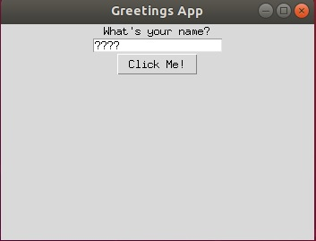
Greetings App Screenshot 1

Slide 24
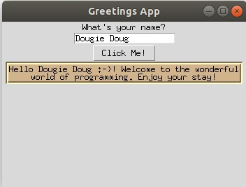
Greetings App Screenshot 2

Slide 25
Run The Demo!
$ python tkinter_greeting_app.py

Slide 26
The Code Part I
import tkinter as tk
root = tk.Tk() # starts a tcl/tk interpreter under the cover
root.title('Greetings App')
root.geometry('350x250')
def greeting():
greetings = tk.Label(root, bg='tan', borderwidth=3.5, relief='groove', text="Hello {} :-)! Welcome to the wonderful\n"
"world of programming. Enjoy your stay!".format(default_value.get()))
greetings.pack()

Slide 27
The Code Part II
default_value = tk.StringVar()
default_value.set('????')
first_name_label = tk.Label(root, text='What\'s your name?').pack()
first_name = tk.Entry(root, textvariable=default_value).pack()
button = tk.Button(text='Click Me!', command=greeting).pack()
tk.mainloop()

Slide 28
Greetings App Analysis
If we want text to appear in the Entry widget itself then there’s no attribute that we can place within the Entry widget. Instead, we need to create what’s called a StringVar variable, and then pass it in as the text variable value of the Entry widget.
A StringVar is in essence part of the variable classes in tkinter; there’s also the BooleanVar, DoubleVar, and IntVar classes. These serve as wrappers for their respective datatype.
default_value = tk.StringVar()
default_value.set('pizza?')
first_name = tk.Entry(root, textvariable=default_value).pack()

Slide 29
Ordering Layouts In Tkinter
There are three ways in which you can control the layout of items in your GUI, they are:
· pack
· grid
· place

Slide 30
Pack
This is the easiest one to use as once you use it the method takes care of the ordering itself.

Slide 31
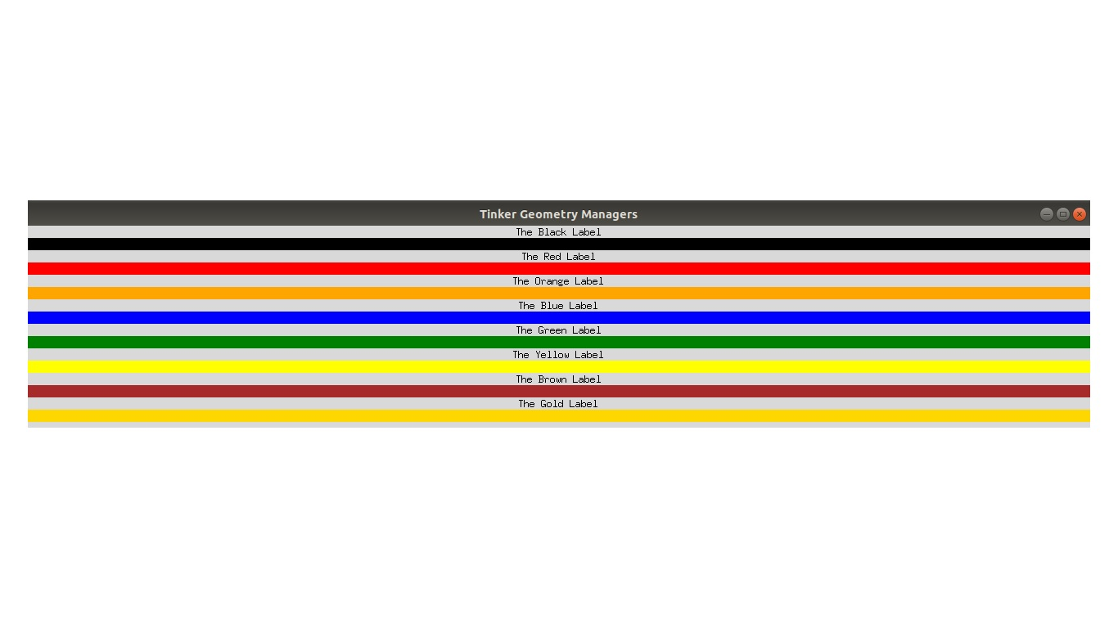
Pack GUI Example

Slide 32
Show The Pack Demo
$ python tkinter_pack.py

Slide 33
Pack Code Snippet Part I
import tkinter as tk
root = tk.Tk()
root.title('Tinker Geometry Managers')
colors = ['black', 'red', 'orange', 'blue', 'green',
'yellow', 'brown', 'gold']
# The label geometry layout manager in Tkinter
label_one = tk.Label(text='The Black Label').pack()
label_one_black = tk.Label(root, bg=colors[0]).pack(fill=tk.X)

Slide 34
Pack Code Snippet Part II
label_two = tk.Label(text='The Red Label').pack()
label_two_red = tk.Label(root, bg=colors[1]).pack(fill=tk.X)
label_three = tk.Label(text='The Orange Label').pack()
label_three_orange = tk.Label(root, bg=colors[2]).pack(fill=tk.X)
label_four = tk.Label(text='The Blue Label').pack()
label_four_blue = tk.Label(root, bg=colors[3]).pack(fill=tk.X)
label_five = tk.Label(text='The Green Label').pack()
label_five_blue = tk.Label(root, bg=colors[4]).pack(fill=tk.X)
label_six = tk.Label(text='The Yellow Label').pack()
label_six_yellow = tk.Label(root, bg=colors[5]).pack(fill=tk.X)

Slide 35
Pack Code Snippet Part III
label_seven = tk.Label(text='The Brown Label').pack()
label_six_brown = tk.Label(root, bg=colors[6]).pack(fill=tk.X)
label_eight = tk.Label(text='The Gold Label').pack()
label_six_gold = tk.Label(root, bg=colors[7]).pack(fill=tk.X)
root.mainloop()

Slide 36
Place
The place layout manager allows you to do absolute and relative positioning with tkinter. So, you can specify exactly where you want a widget to appear in the GUI.

Slide 37
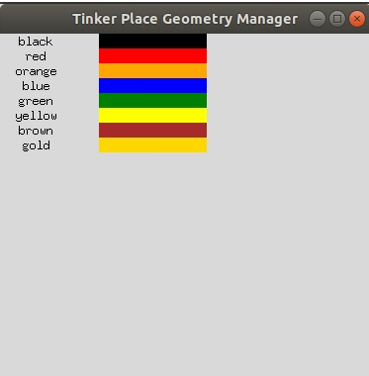
Place Geometry Manager

Slide 38
Run Place Demo
$ python tkinter_place_example.py

Slide 39
Place Code Snippet
import tkinter as tk
root = tk.Tk()
root.title('Tinker Place Geometry Manager')
root.geometry('375x350')
colors = ['black', 'red', 'orange', 'blue', 'green',
'yellow', 'brown', 'gold']
width, height = 0, 0
for x in range(len(colors)):
tk.Label(text=colors[x], width=10).place(x=0, y=height)
tk.Label(bg=colors[x], width=15).place(x=100, y=height)
height += 15
tk.mainloop()

Slide 40
Grid
The last layout manager to explain is the grid. It organizes components of the GUI by placing them in a 2-dimensional table which consists of rows and columns.

Slide 41
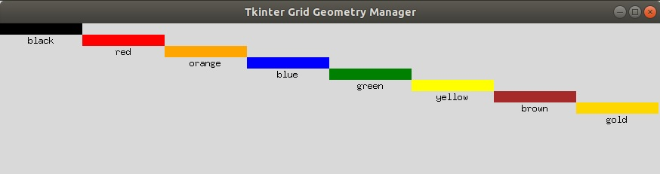
Grid Example

Slide 42
Run Grid!
$ python tkinter_grid_example.py

Slide 43
Grid Code Snippet
import tkinter as tk
root = tk.Tk()
root.title('Tkinter Grid Geometry Manager')
root.geometry('875x200')
colors = ['black', 'red', 'orange', 'blue', 'green',
'yellow', 'brown', 'gold']
i = 0
for x in colors:
tk.Label(text=x, width=15).grid(row=i+1, column=i)
tk.Label(bg=x, width=15).grid(row=i, column=i)
i += 1
tk.mainloop()

Slide 44
Converting to OOP
import tkinter as tk
class HelloWorld:
def __init__(self):
self.root = tk.Tk()
self.root.title('Simple Tkinter Class Example')
self.root.geometry('500x500')
if __name__ == '__main__':
app = HelloWorld()
tk.mainloop()

Slide 45
Temperature Converter
Run program:
$ python fahrenheit_to_celsius.py
Read project and solution here: https://github.com/purcellconsult/Code-Cool-Stuff-With-Python/blob/master/book/chapter_05.md#project-temperature-converter-gui

Slide 46
BMI Calculator
$ python bmi_calculator
Analyze project and here: https://github.com/purcellconsult/Code-Cool-Stuff-With-Python/blob/master/book/chapter_05.md#project-bmi-calculator-app

Slide 47
Guessing Game
$ Run program: python secret_number_game.py
Analyze project and code here: https://github.com/purcellconsult/Code-Cool-Stuff-With-Python/blob/master/book/chapter_05.md#project-the-secret-number-game

Slide 48
Hope You Didn’t Forget This :)!
import tkinter as tk
root = tk.Tk()
root.title('Simple Tkinter App')
root.geometry('500x500')
tk.mainloop()

Slide 49
Thanks! Connect With Me on LinkedIn!
I’m active on LinkedIn plus my messages there are way less cluttered than email. Simply search Doug Purcell on LinkedIn, I should appear numeral uno
Need help with understanding python’s basics? Complete my free course on GitHub: https://github.com/purcellconsult/Cracking-Python-Bootcamp
Email me if you need any python help. My email is: purcellconsult@gmail.com. If I meet you in person make sure to jot my memory of the meetup or conference.

